Slide 1
Introduction to sample size and power calculations
How much chance do we have to reject the null hypothesis when the alternative is in fact true?
(what’s the probability of detecting a real effect?)

Slide 2
Can we quantify how much power we have for given sample sizes?

Slide 3
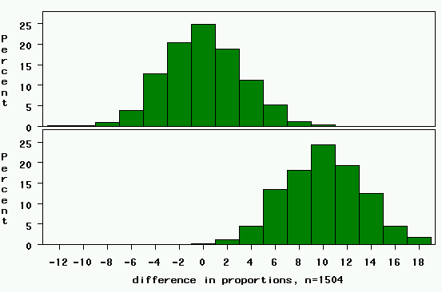
study 1: 263 cases, 1241 controls
Rejection region. Any value >= 6.5 (0+3.3*1.96)
Null Distribution: difference=0.
For 5% significance level, one-tail area=2.5%
(Z_{α/2} = 1.96)
Power= chance of being in the rejection region if the alternative is true=area to the right of this line (in yellow)→
Clinically relevant alternative: difference=10%.

Slide 4
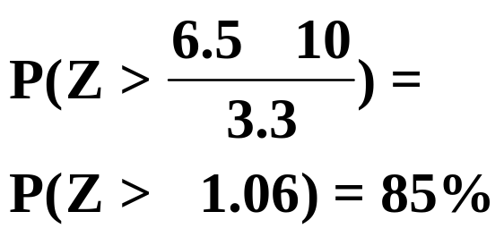
study 1: 263 cases, 1241 controls
Rejection region. Any value >= 6.5 (0+3.3*1.96)
Power= chance of being in the rejection region if the alternative is true=area to the right of this line (in yellow)
Power here:

Slide 5
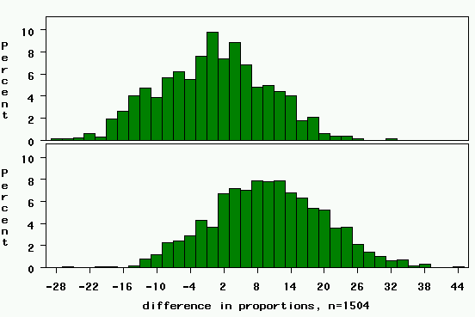
study 1: 50 cases, 50 controls
Critical value= 0+10*1.96=20
Z_{α/2}=1.96
2.5% area
Power closer to 15% now.

Slide 6
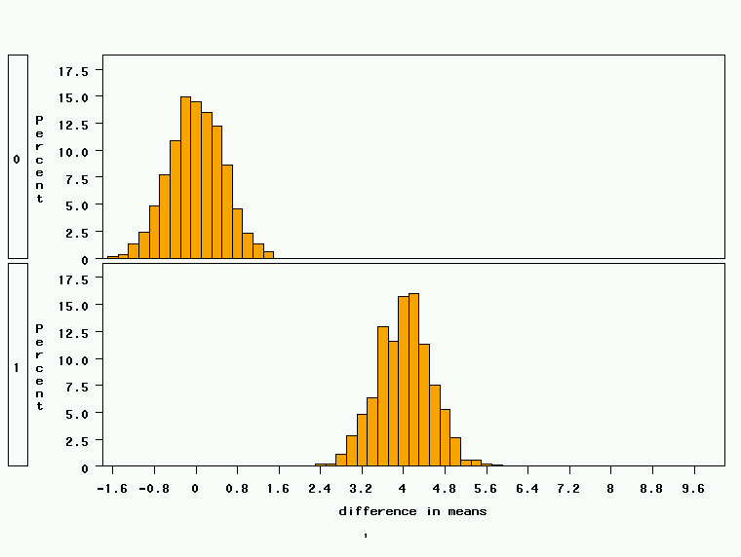
Study 2: 18 treated, 72 controls, STD DEV = 2
Critical value= 0+0.52*1.96 = 1
Clinically relevant alternative: difference=4 points
Power is nearly 100%!

Slide 7
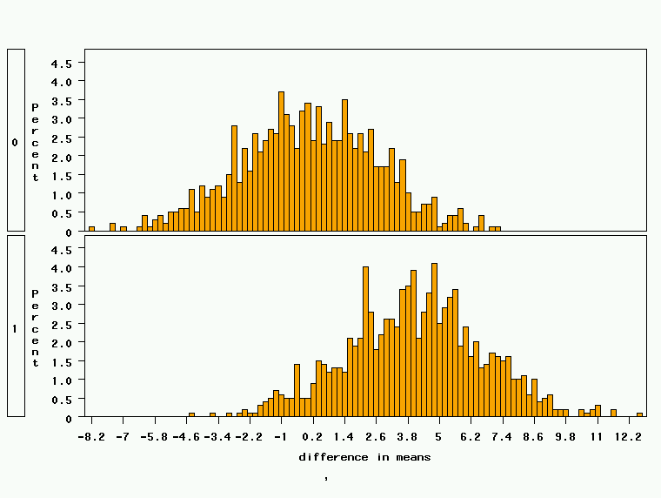
Study 2: 18 treated, 72 controls, STD DEV=10
Critical value= 0+2.58*1.96 = 5
Power is about 40%

Slide 8
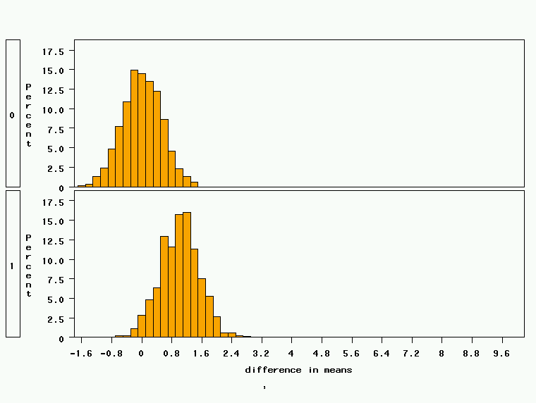
Study 2: 18 treated, 72 controls, effect size=1.0
Critical value= 0+0.52*1.96 = 1
Power is about 50%
Clinically relevant alternative: difference=1 point

Slide 9
Factors Affecting Power
1. Size of the effect
2. Standard deviation of the characteristic
3. Bigger sample size
4. Significance level desired
Notes:
It turns out that if you were to go out and sample many, many times, most sample statistics that you could calculate would follow a normal distribution.
What are the 2 parameters (from last time) that define any normal distribution?
Remember that a normal curve is characterized by two parameters, a mean and a variability (SD)
What do you think the mean value of a sample statistic would be? The standard deviation?
Remember standard deviation is natural variability of the population
Standard error can be standard error of the mean or standard error of the odds ratio or standard error of the difference of 2 means, etc. The standard error of any sample statistic.

Slide 10
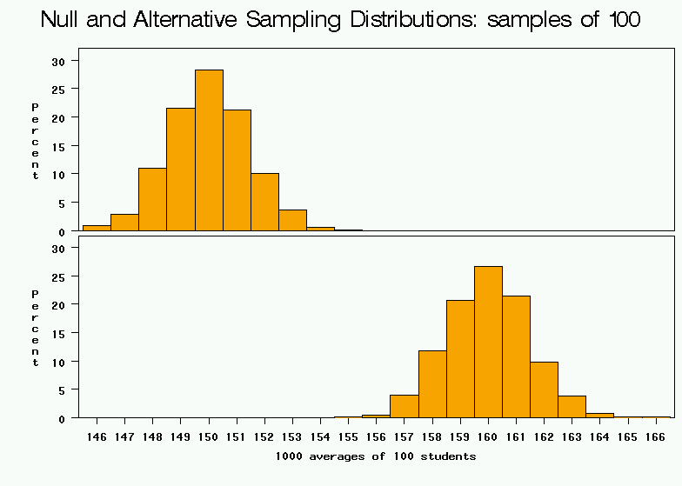
1. Bigger difference from the null mean
Null
Clinically relevant alternative
average weight from samples of 100

Slide 11
2. Bigger standard deviation
average weight from samples of 100

Slide 12
3. Bigger Sample Size
average weight from samples of 100

Slide 13
4. Higher significance level
Rejection region.
average weight from samples of 100

Slide 14
Sample size calculations
Based on these elements, you can write a formal mathematical equation that relates power, sample size, effect size, standard deviation, and significance level…
**WE WILL DERIVE THESE FORMULAS FORMALLY SHORTLY**

Slide 15
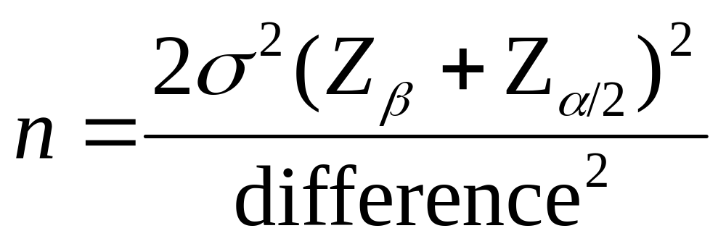
Simple formula for difference in means
Represents the desired power (typically .84 for 80% power).
Sample size in each group (assumes equal sized groups)
Represents the desired level of statistical significance (typically 1.96).
Standard deviation of the outcome variable
Effect Size (the difference in means)

Slide 16
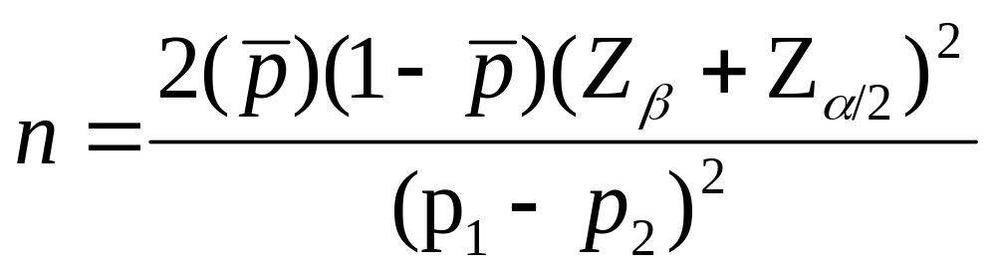
Simple formula for difference in proportions
Represents the desired power (typically .84 for 80% power).
Sample size in each group (assumes equal sized groups)
Represents the desired level of statistical significance (typically 1.96).
A measure of variability (similar to standard deviation)
Effect Size (the difference in proportions)

Slide 17
Derivation of sample size formula….

Slide 18
Study 2: 18 treated, 72 controls, effect size=1.0
Critical value= 0+.52*1.96=1
Power close to 50%

Slide 19
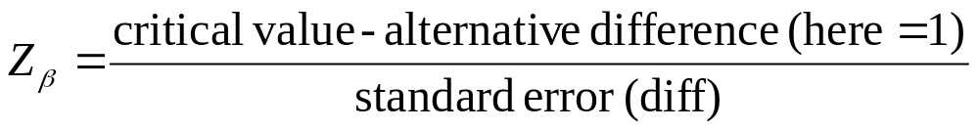
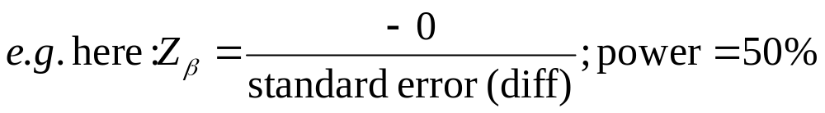
SAMPLE SIZE AND POWER FORMULAS
Critical value=
0+standard error (difference)*Z_{α/2}
Power= area to right of Z_{β}=

Slide 20
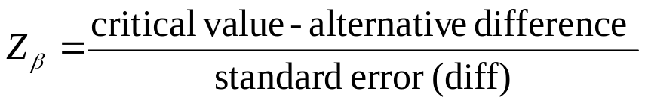
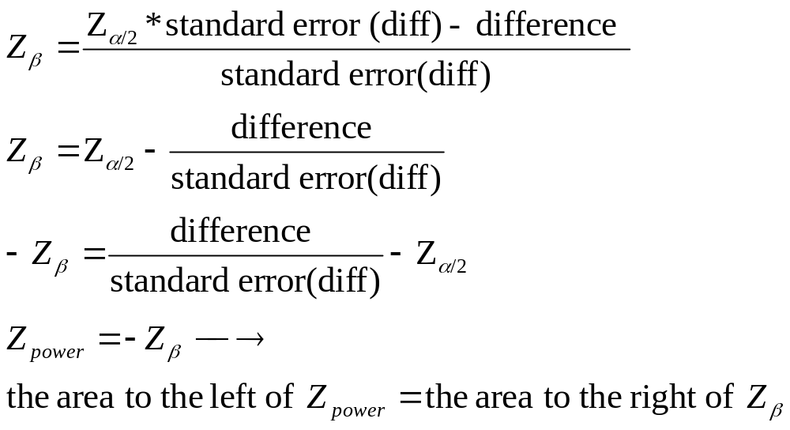
Power= area to right of Z_{β}=
Power is the area to the right of Z_{β}. OR power is the area to the left of - Z_{β}.
Since normal charts give us the area to the left by convention, we need to use
- Z_{β} to get the correct value. Most textbooks just call this “Z_{β}”; I’ll use the term Z_{power} to avoid confusion.

Slide 21
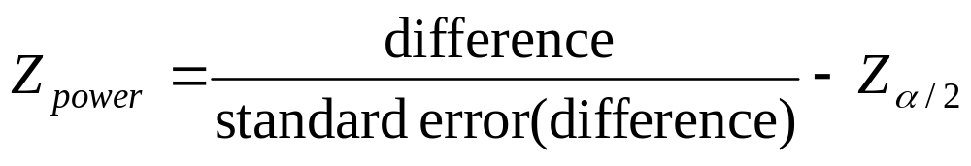
All-purpose power formula…

Slide 22
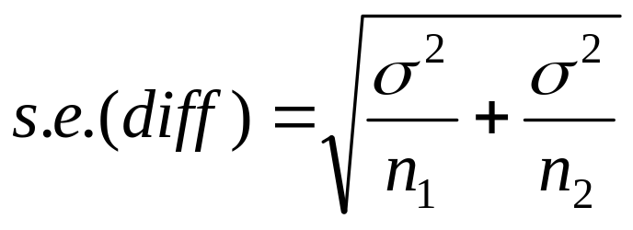
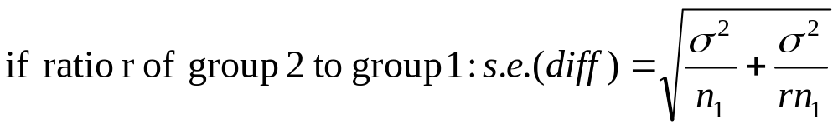
Derivation of a sample size formula…
Sample size is embedded in the standard error….

Slide 23
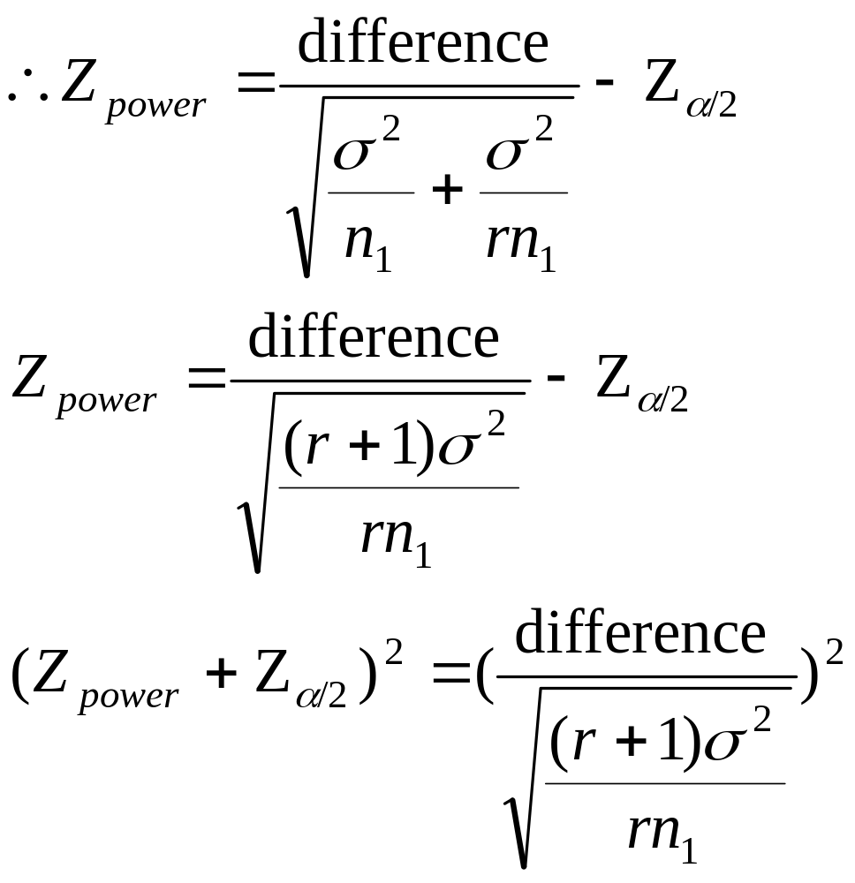
Algebra…

Slide 24
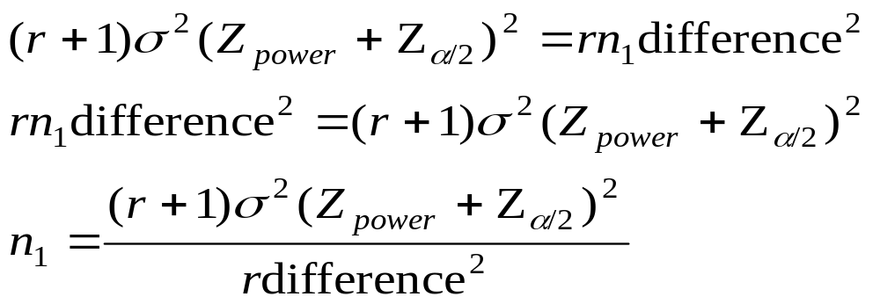
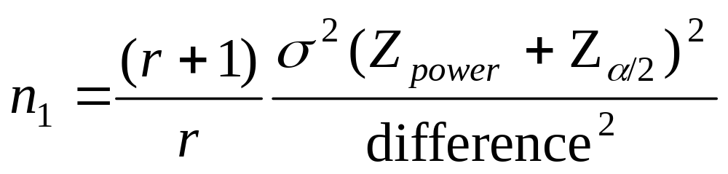
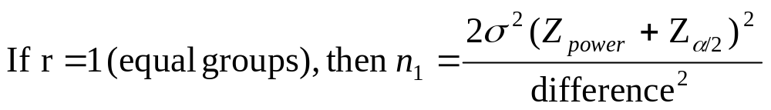

Slide 25
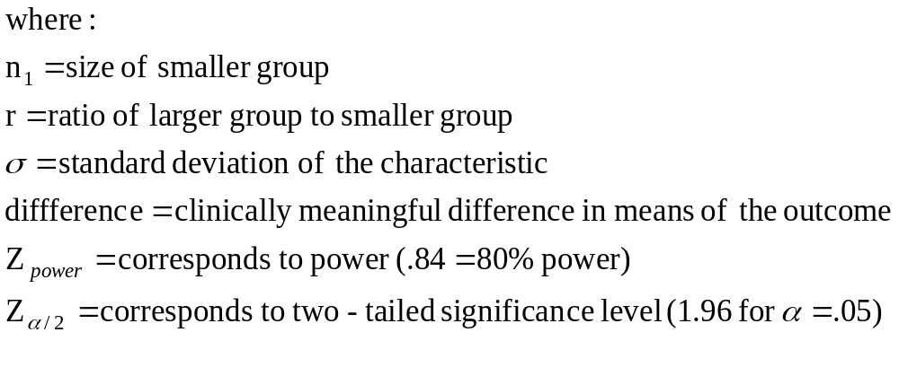
Sample size formula for difference in means

Slide 26
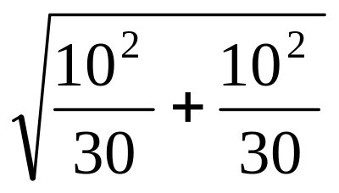
Examples
Example 1: You want to calculate how much power you will have to see a difference of 3.0 IQ points between two groups: 30 male doctors and 30 female doctors. If you expect the standard deviation to be about 10 on an IQ test for both groups, then the standard error for the difference will be about:
= 2.57

Slide 27
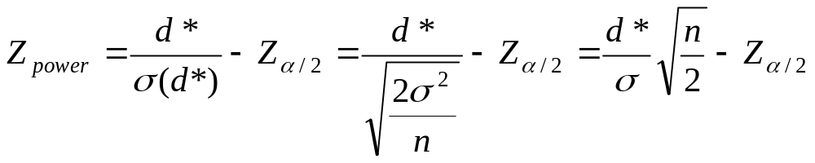

Power formula…
P(Z≤ -.79) =.21; only 21% power to see a difference of 3 IQ points.

Slide 28
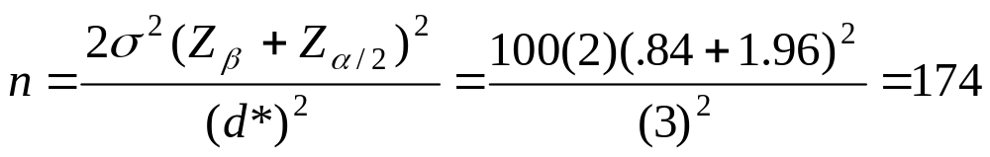
Example 2: How many people would you need to sample in each group to achieve power of 80% (corresponds to Z_{β}=.84)
174/group; 348 altogether

Slide 29
Sample Size needed for comparing two proportions:
    Example: I am going to run a case-control study to determine if pancreatic cancer is linked to drinking coffee. If I want 80% power to detect a 10% difference in the proportion of coffee drinkers among cases vs. controls (if coffee drinking and pancreatic cancer are linked, we would expect that a higher proportion of cases would be coffee drinkers than controls), how many cases and controls should I sample? About half the population drinks coffee.

Slide 30
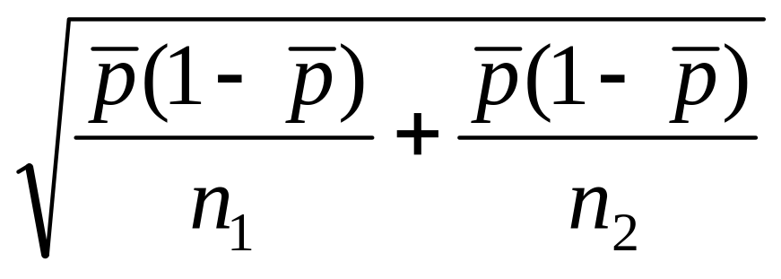
Derivation of a sample size formula:
    The standard error of the difference of two proportions is:

Slide 31
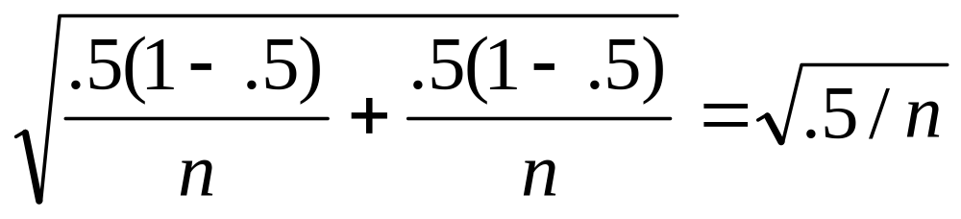
Derivation of a sample size formula:
Here, if we assume equal sample size and that, under the null hypothesis proportions of coffee drinkers is .5 in both cases and controls, then
s.e.(diff)=

Slide 32
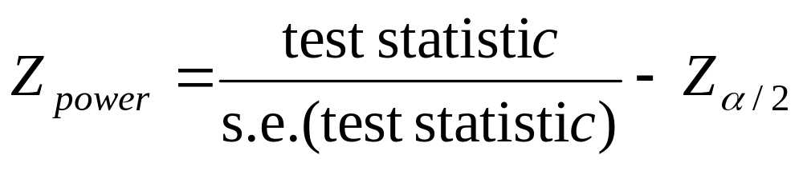


Slide 33
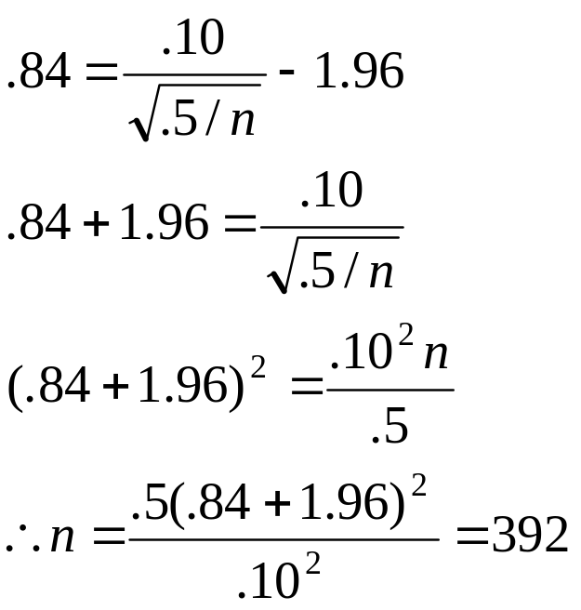
For 80% power…
There is 80% area to the left of a Z-score of .84 on a standard normal curve; therefore, there is 80% area to the right of -.84.
Would take 392 cases and 392 controls to have 80% power!
Total=784

Slide 34
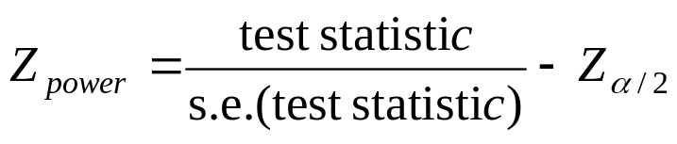
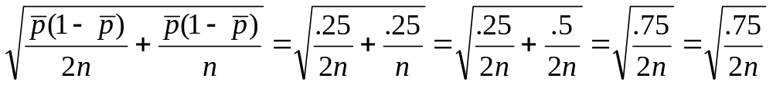
Question 2:
    How many total cases and controls would I have to sample to get 80% power for the same study, if I sample 2 controls for every case?
    Ask yourself, what changes here?

Slide 35
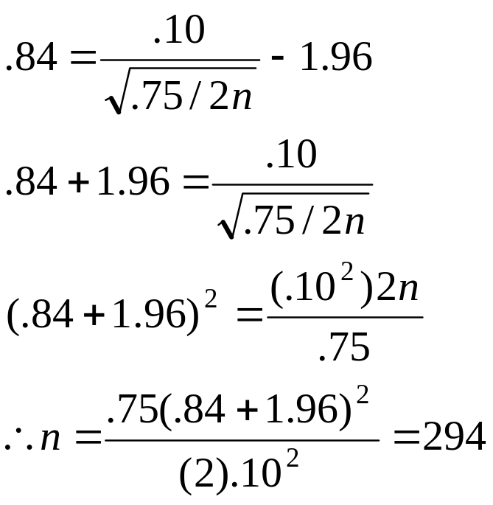
Different size groups…
Need: 294 cases and 2x294=588 controls. 882 total.
Note: you get the best power for the lowest sample size if you keep both groups equal (882 > 784). You would only want to make groups unequal if there was an obvious difference in the cost or ease of collecting data on one group. E.g., cases of pancreatic cancer are rare and take time to find.

Slide 36
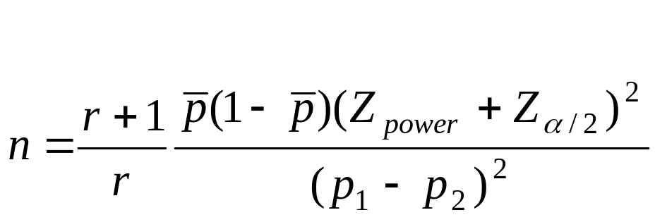
General sample size formula

Slide 37
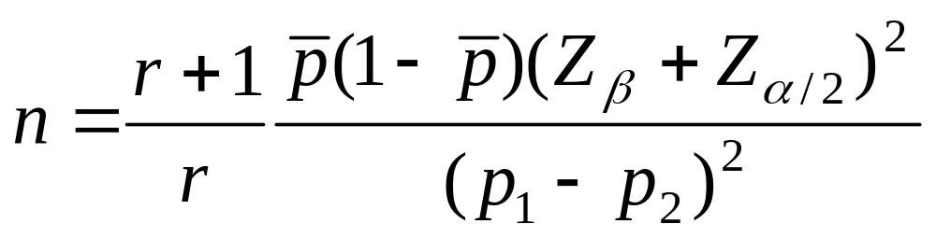
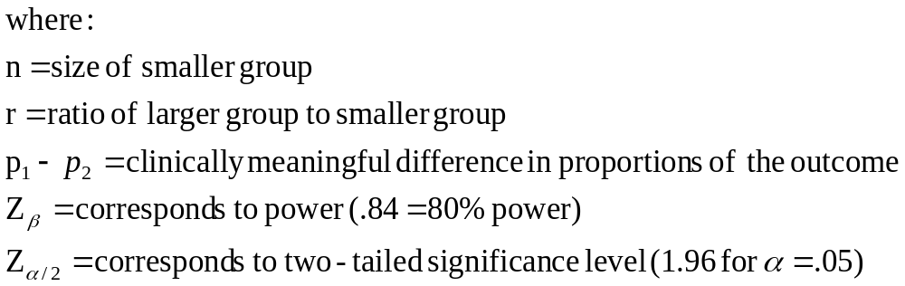
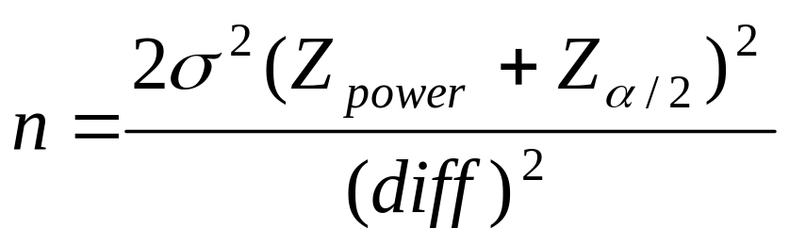
General sample size needs when outcome is binary:

Slide 38
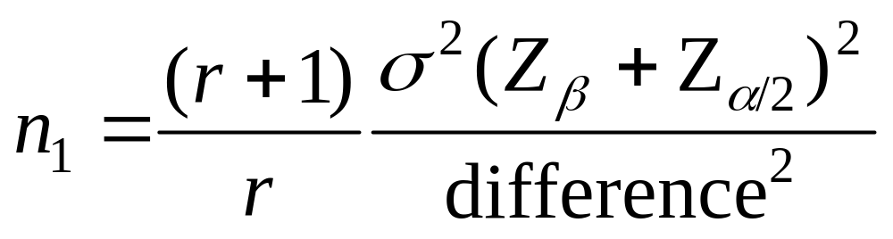
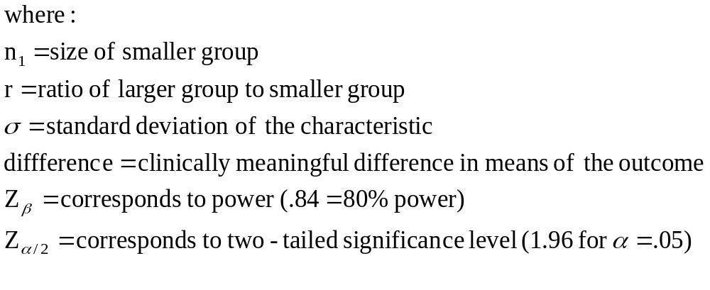
Compare with when outcome is continuous:

Slide 39
Question
    How many subjects would we need to sample to have 80% power to detect an average increase in MCAT biology score of 1 point, if the average change without instruction (just due to chance) is plus or minus 3 points (=standard deviation of change)?

Slide 40
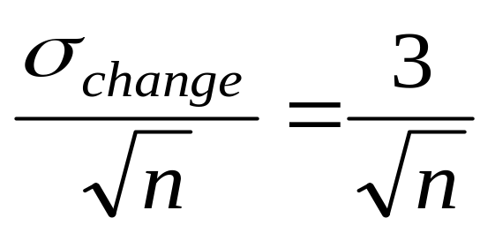
Standard error here=

Slide 41
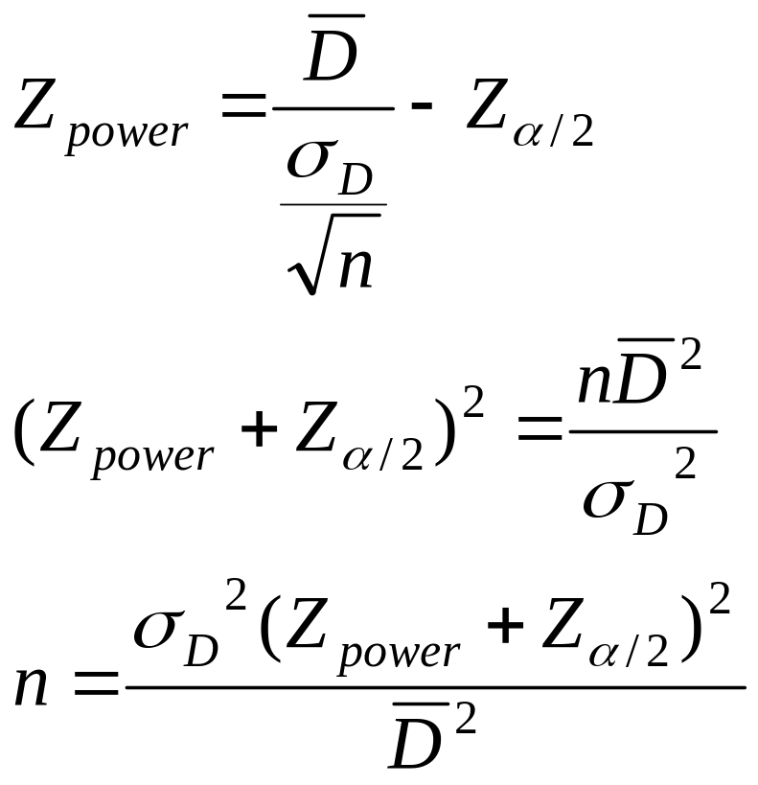
Where D=change from test 1 to test 2. (difference)
Therefore, need: (9)(1.96+.84)²/1 = 70 people total

Slide 42
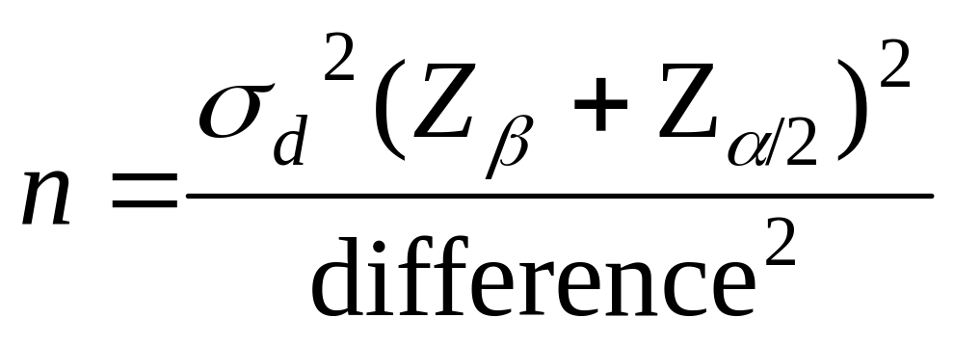
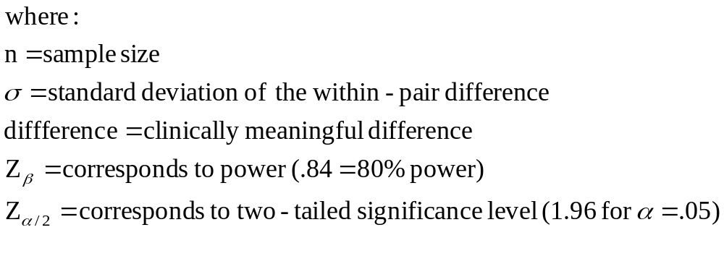
Sample size for paired data:

Slide 43
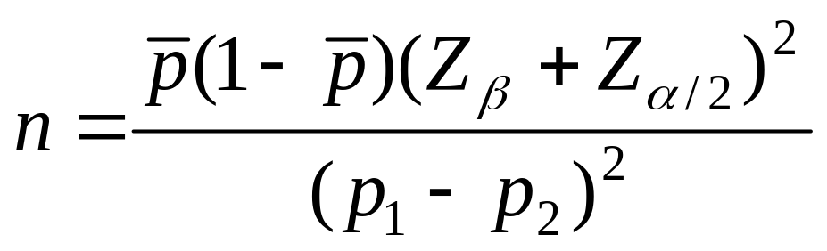
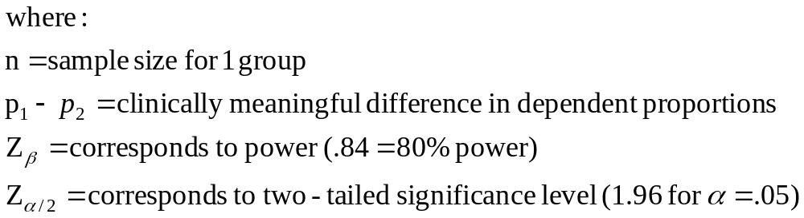
Paired data difference in proportion: sample size:

